Slide 1
Typhon Tutorial GCU Students

Slide 2
Welcome to Typhon
Hello GCU students,
First, let me say thank you for your patience as we navigate this change in our program
The Typhon web-based time logs are being adopted to simplify the hour collection process, the approval of hours, and accessibility to hours for GCU counseling students. As in most software implementations, this one will not be without a learning curve for students, faculty and staff. In the log term, this software application will provide students with an easier way to submit hours (previous paper logs required scanning and faxing), and it provides a cumulative record as students progress through practicum, courses. Records remain accessible 3 years after graduation.
Your class is the first class chosen to use the web-based application. It is crucial we receive feedback about the application and this process. You may send that feedback to me at Kathy.britton@gcu.edu.
Thank you again for your patience and help.
Have a great class!
-Kathy Britton
Academic Program Manager

Slide 3
The Start
After a student posts for the first time in their LoudCloud classroom, they will receive an emailed invitation to sign onto the Typhon website.
The email should arrive before the end of the first week of class.
If the student does not receive an email, and have posted in their LoudCloud classroom, the student should contact their Office of Field Experience specialist.
Students should NOT contact their Student Service Advisor about Typhon related issues.

Slide 4
Typhon: Invite Email

Slide 5
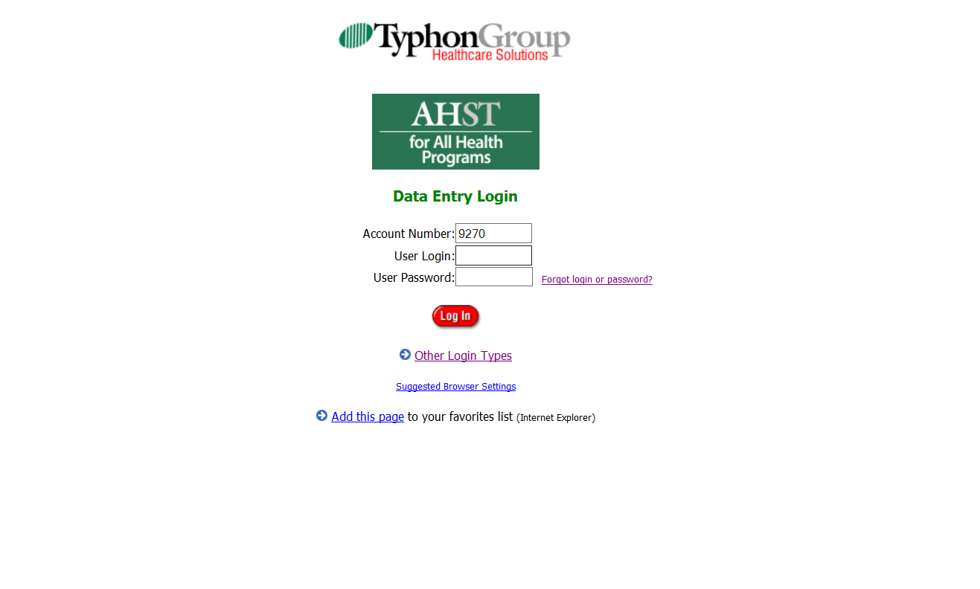
Typhon: Sign on screen
This is the screen that you will use the Typhon provided information to sign onto for the 1st time.

Slide 6
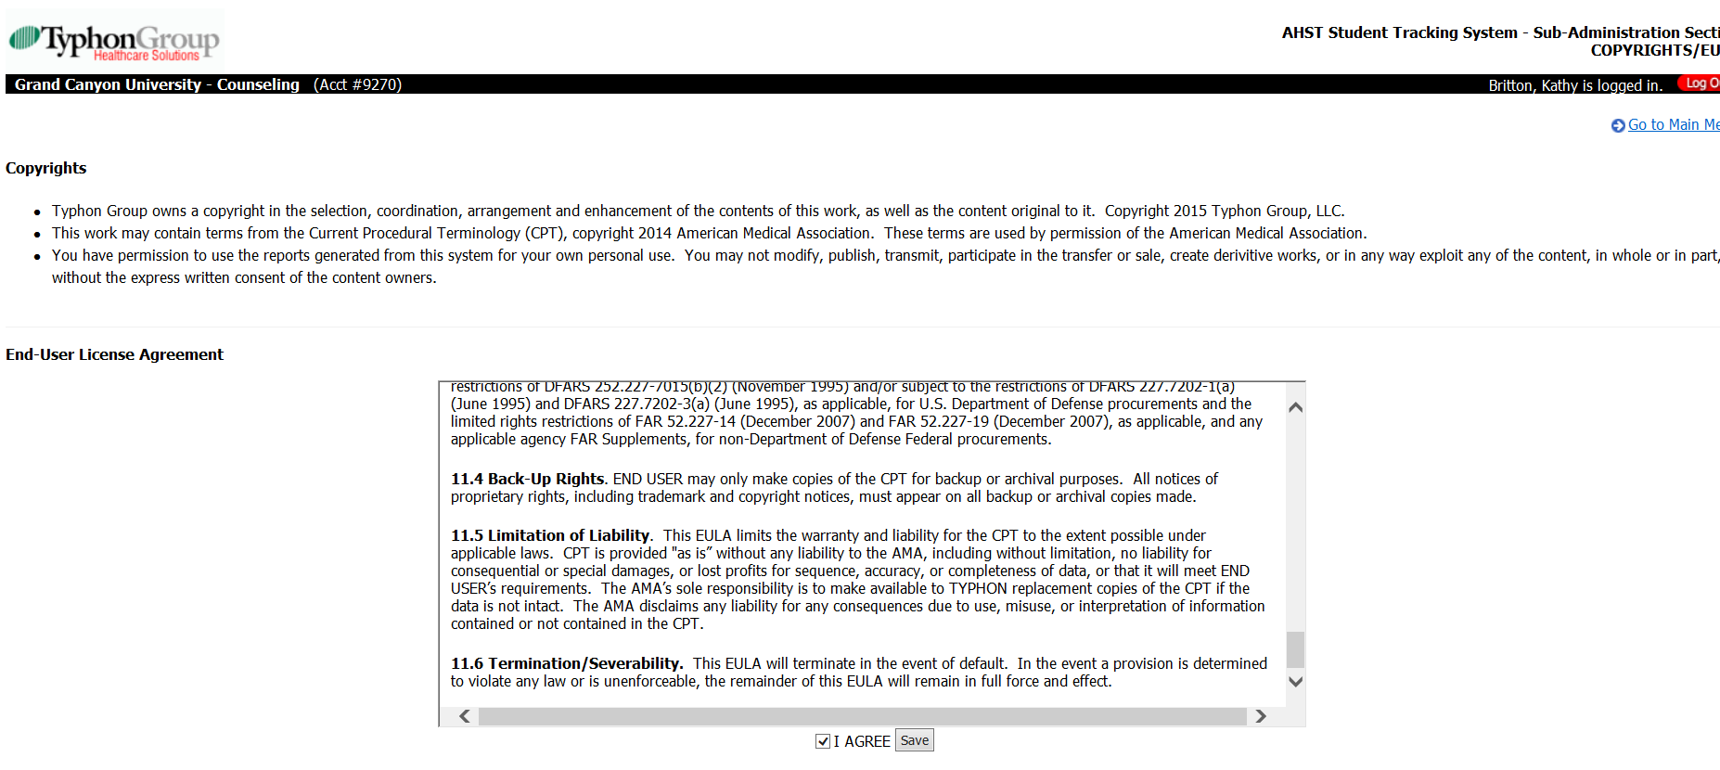
Typhon: Security Agreement

Slide 7
Check Your Browser

Slide 8
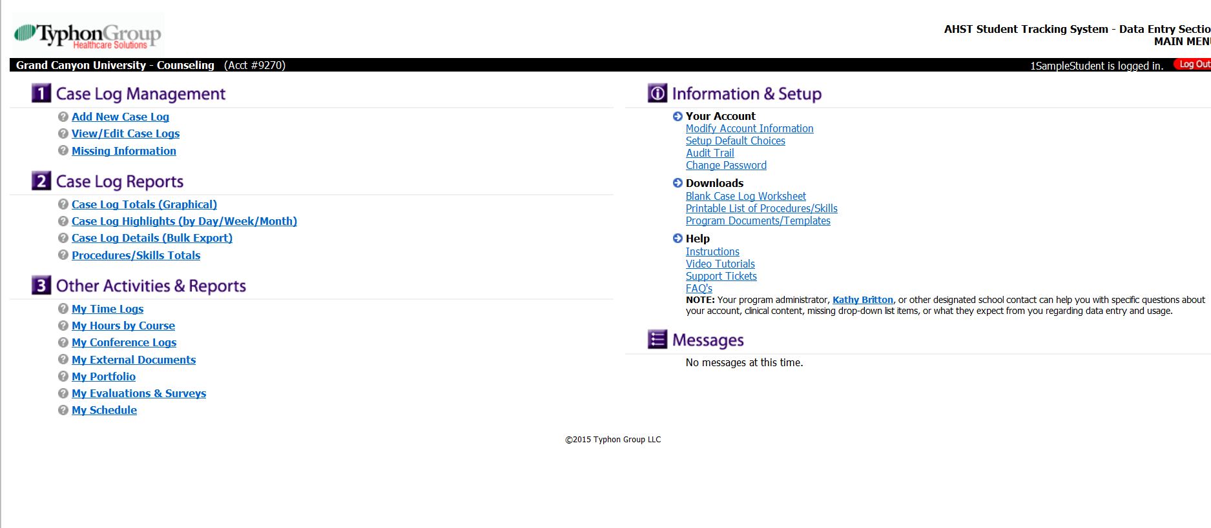
Typhon: Initial Screen

Slide 9
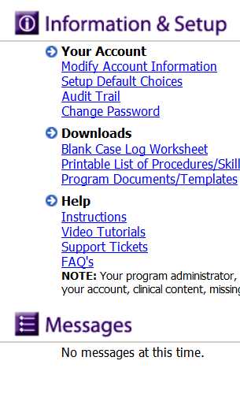
Typhon: Initial Screen
This is where you will set your password.
Disregard any ‘case logs’ references. Counseling students do not need to record case logs, just time logs.

Slide 10
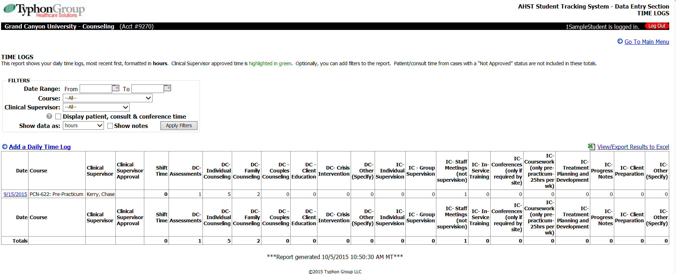
Typhon: Time Logs
You must record hours on a daily basis.

Slide 11
Typhon: Add Daily Log

Slide 12
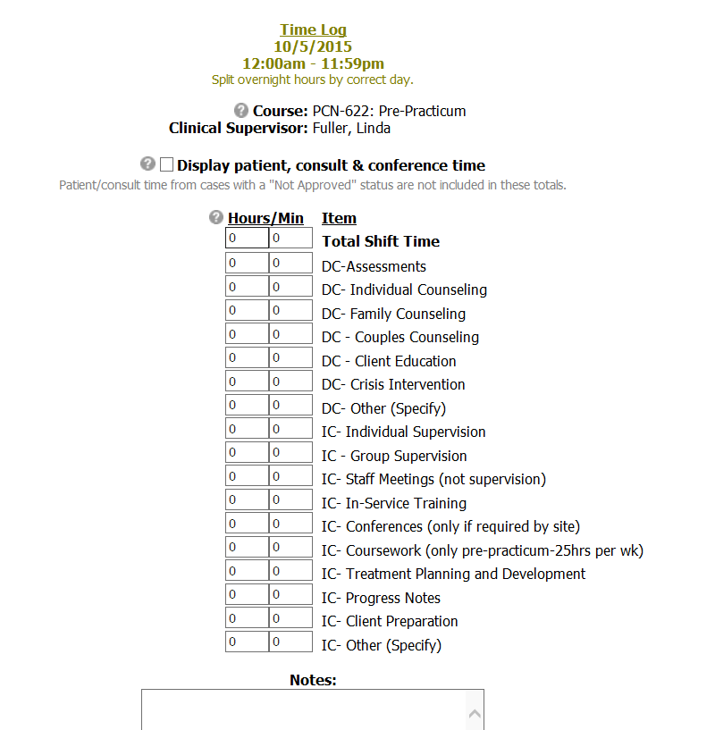
Typhon: Daily Log
Make sure you save your data!
For any hours you enter in ‘other’ you must give a description of what exactly the activities were.

Slide 13
Typhon
Once hours are loaded into Typhon, the student is done. No case logs will be recorded.
Other professions (Nursing) require case-specific data, counseling students do not.

Slide 14
Contacts
If you encounter problems in signing on or time log entry, contact your Office of Filed Experience Specialist first. Do not contact your SSA!
Other contacts in order of suggested contact:
1st- Assigned Instructor: send them a question via LoudCloud
2nd- OFE specialist
3rd - Counseling Program Manager: kathy.britton@gcu.edu
4th - Typhon Help Desk:

